Slide 1
SAP Leonardo IoT

Slide 2
Agenda
Agenda
Introduction to IoT
Sensors, Connectivity & SAP Cloud Platform
SAP Cloud platform IoT service on-boarding and service cockpit
SAP Leonardo IoT Foundation – Technical Services
SAP Leonardo Device Management
Edge Computing
SAP IoT Application Enablement

Slide 3
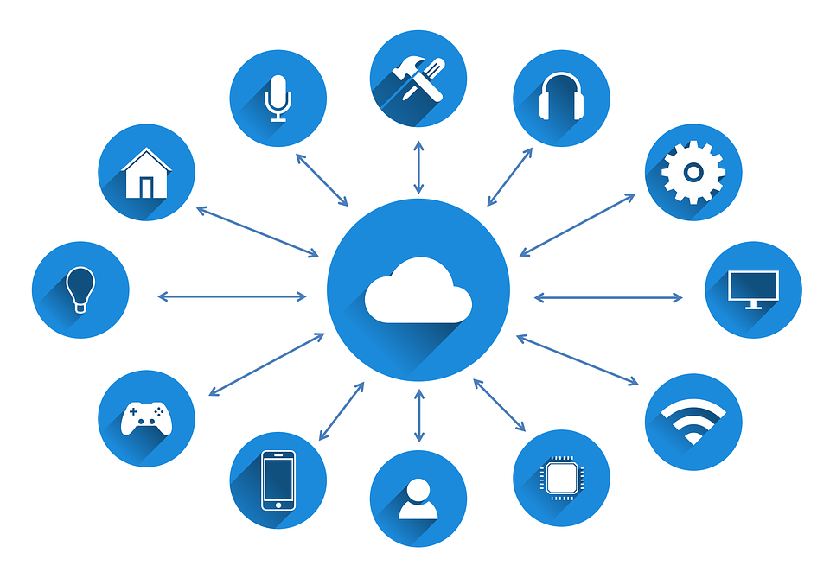
What is IoT..?
Internet of Things (IoT) is a network of devices which can sense, accumulate and transfer data over the internet without any human intervention.

Slide 4
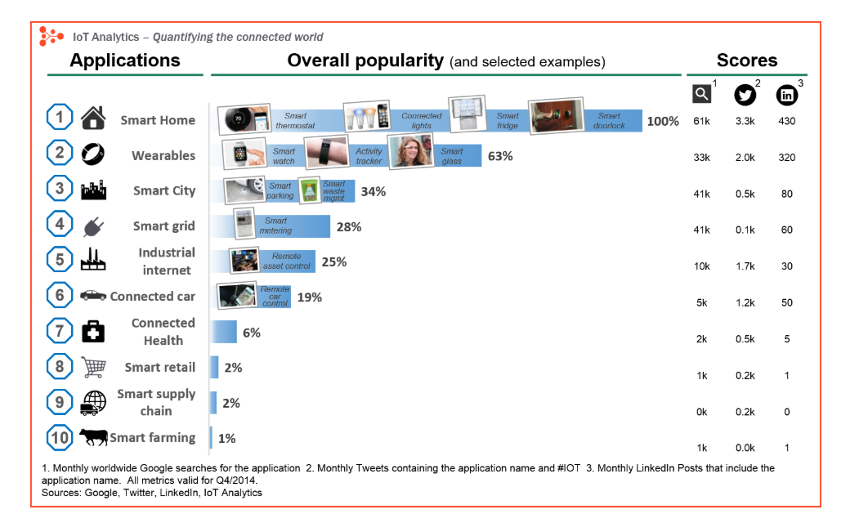
IoT Applications:

Slide 5
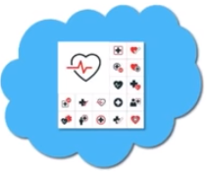
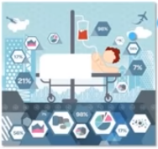

Why do we need IoT..?
Let’s look at an example, The patient is at constant life-support at home where his health-status is being checked to a health monitoring system present on the cloud, Suppose If there is some irregularity in heart beat the system on the cloud is connected to a hospital. So based on his condition the hospital authorities enable to dispatch an ambulance immediately.

Slide 6
Why do we need IoT..?
It increases transparency
Reduces lot of effort and time
EXPANDING
Interdependence
OF HUMANS
to
INTERACT
CONTRIBUTE
&
COLLABORATE
TO THINGS

Slide 7
Benefits of IoT
Efficient “RESOURCE UTILIZATION”
Minimizing Human Effort
Saves Time
Development of AI through IoT
Improvement of security
Increases transparency

Slide 8
IoT Features…
Connect various things to the IoT Platform
CONNECT
ANALYZE
Analyze the data collected and use it to build Business intelligence
INTEGRATE
Integrate various models to improve user experience

Slide 9

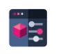
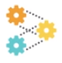


IoT Ecosystem
Business Layer
Manages the whole IoT System, including applications,
Business and profit models, and user’s privacy
Application Layer
Responsible for delivering application specific services to the user
Processing Layer
Stores, analyses, and processes huge amounts of data. Employs Databases, cloud computing & big data processing modules.
Transport Layer
Transfers the sensor data between different layer through networks Such as wireless, 3G, LAN, Bluetooth, RFID, and NFC
Perception Layer
Sensors sense and gather information about the environment

Slide 10
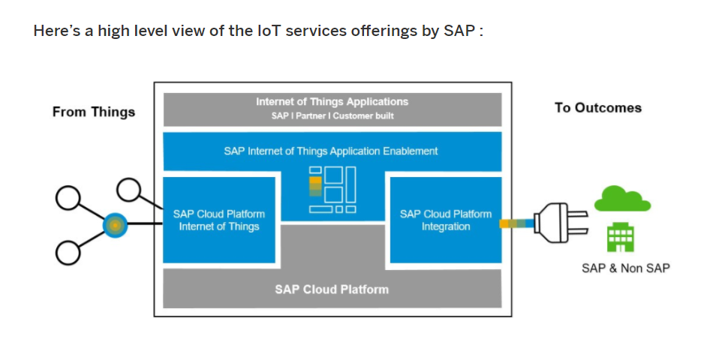
IoT Offerings:
IoT is one of the pillars of Leonardo as it bridges the physical world and the business world together that results in enormous possibilities to extract insights out of the real world data generated by intelligent devices and sensors.

Slide 11
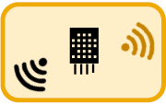
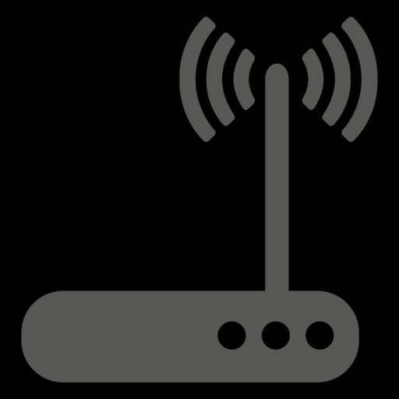
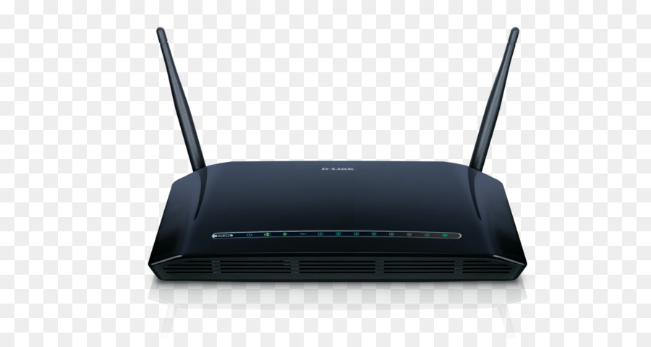
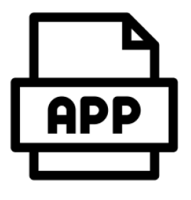
Sensors, Connectivity & SAP Cloud Platform
Process the IOT sensor Data and also the business Data
How internet of things works?
Devices
Gateway
Back-End Systems
Applications
Business
Locally Connected
ERP
IoT Platform
Sensor Data
Sensor Data can be sent via some gateways
On-Cloud
Directly Connected
On-Premise
Sensor Data can be sent directly to the back end
Analyse, Process and visualize the data, to turn it into useful insights.
Sensor Enabled Devices collects information/Data

Slide 12



Sensors, Connectivity & SAP Cloud Platform
What is a Sensor?
A sensor is a small device that identifies information from its physical surroundings.
Transducer
Technically, a sensor device is a transducer, which consists of a sensor for measuring the actual value and a signal conditioner to convert the measurement into meaningful information.
Measuring Quantity
Sensor
Signal Conditioning
Meaningful Info
If the sensor detects a change in the environment, it records, indicates, or otherwise responds to it.
Local or Remote Receiving System
Sensor Device
Signal
Processors
Emitter
Message Receiving System
Signal
Message :
JSON, XML etc.
Signal
Protocol: HTTP or MQTT
Signal
Connectivity :
BLE, Bluetooth, 4G, 2G etc.
Sensors
Security
Configurations

Slide 13



Sensors, Connectivity & SAP Cloud Platform
Wi-Fi
Bluetooth
RFID
Connectivity :
Cloud Connected
A directly connected sensor can connect to back-end systems and send data using high-speed Internet.
These types of sensors are based on Wi-Fi, 2G, 3G, 4G LTE, etc.
Locally Connected
A locally connected sensor depends on nearby gateways, smartphones, or other means to deliver messages to back-end systems.
These sensors are based on Bluetooth/BLE or ZigBee.
Back-End Systems
Business
Directly Connected
ERP
IoT Platform
Locally Connected
Sensor Data
Gateway
On-Cloud
On-Premise

Slide 14

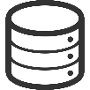



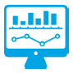
Sensors, Connectivity & SAP Cloud Platform
SAP Cloud Platform – What is it?
SAP Cloud Platform is an open platform-as-a-service (PaaS) that delivers in-memory capabilities, core platform services, and unique micro-services for building and extending intelligent applications.
Combine Data from different sources for deeper insights
Back-End Systems
Applications
Insights and Actions
Device Data
Sensor Data
Master Data
Monitoring
Business Data
Rules
Processes
Historical
Notifications
Systems
ERP
(CRM, HCM, SCM)
And IOT Platform
Analytics

Slide 15
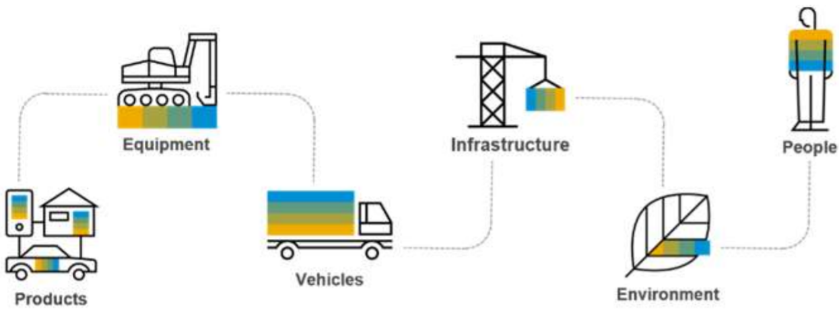
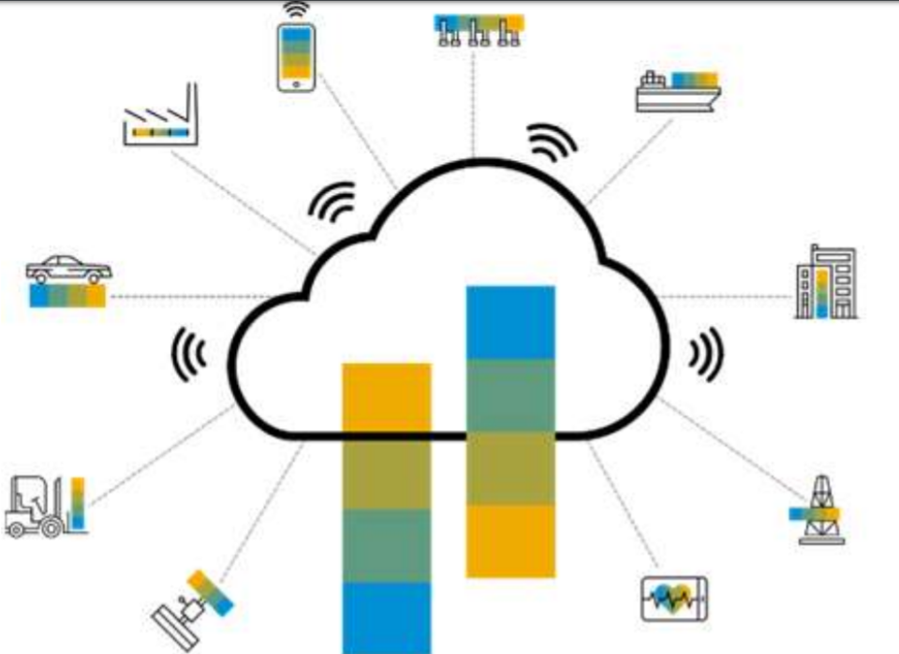
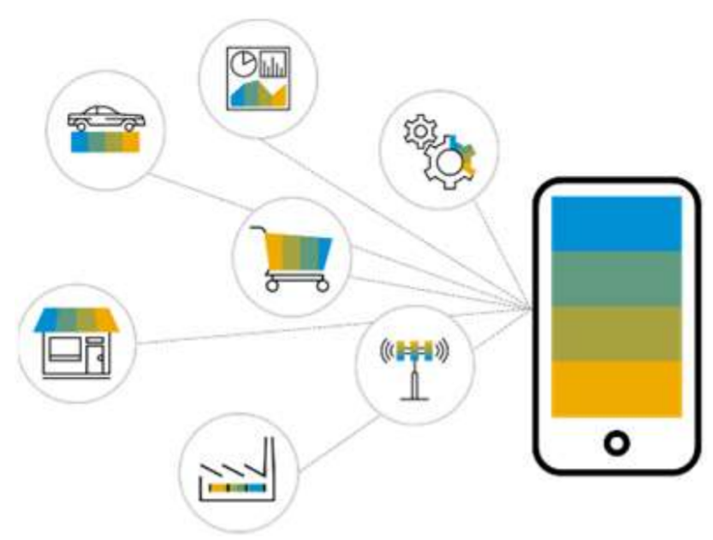
SAP’s Vision for an IOT Platform
Every “Thing” is Connected
Customers and users are more informed and empowered
24/7 Data availability
Every “Thing” is Intelligent
Machine Learning
Artificial Intelligence
3D Printing
Predictive Processes
Products are Smarter
Every “Thing” is in the moment
Online Ordering
2-Hour Delivery
Real-Time Decisions
Predictive Analytics

Slide 16
SAP Leonardo IoT – Technical Architecture
SAP Cloud Platform
Cloud Protocols
HTTPS / MQTT
F
IoT Service
IoT Gateway Cloud
R
IoT core Services
R
IoT Services Cockpit
R
Device
Send and receive messages
CF(PaaS)
IoT Admin
IoT Application
IoT Message Management Service
R
IoT Application Builder
R
Device
IoT Gateway
Edge
R
IoT Application User
Edge Protocols
such as:
HTTPS, MQTT, File, CoAP, SNMP, XMPP, Modbus
(continuous integration of further protocols)
Backing Service (e.g., Postgres SQL, HANA, Kafka)
R
IoT Gateway
Plug-Ins
Eclipse Plug-Ins(SDKs)
MQTT
File
SNMP
LoRa*
OPC UA*
HTTP
ModBus
CoAP
Sigfox*
IoT Gateway SDK
IoT Service SDK

Slide 17
SAP Device Management – Functional Capabilities
Connect with any device or machine anywhere, right away
Connect all wired and wireless “things” to the IoT
No custom development required
Make monitoring “things” easier
Connect one device or millions
Support multiple on-boarding methods
Deploy centrally or at the device ‘edge’
Send actions and changes to connected devices and machines
Interact with connected “things” bi-directionally
Remotely monitor and control one or many devices
Address the health status of devices
Reduce IoT device replacements and servicing
Acquire, transform and move data from “things” anywhere
Collect data for storage in SAP databases and applications
Convert data into a format that can be more easily consumed by target SAP applications
Send most relevant data to the appropriate target application
Receive a complete data set, every time
Accelerate the implementation of IoT use cases
Leverage the Internet of Things faster and more affordably
Eliminate the biggest barriers to IoT-enabled business transformation
Engage in “servitization” by creating innovative digital services and business models based on data from assets and sensors

Slide 18
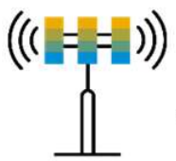
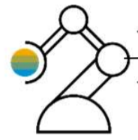
SAP Leonardo IOT Foundation – Technical Services
SAP IoT Application Enablement
Key capabilities
Bi-directional data exchange: Receive device data and send commands to remote devices
REST APIs for device modelling and data consumption
Certificate-based on-boarding and authentication of devices
Guaranteed Delivery Edge to Cloud
Buffering When Not Connected
Scheduled / Batched Delivery
Device Firmware upgrades for devices that support it
IoT Gateway protocol support
Notification management (alerts / rules / events)
SDK for development of custom protocol adapters and custom filters (interceptors)
Start quickly using guidelines, tutorials, and code examples coming with the Starter Kit for the SAP Cloud Platform IoT publicly available on GitHub
SAP Cloud Platform Internet Of Things
MQTT
HTTPS
IOT Gateway Cloud
IoT Cockpit
Configure | Monitor | Optimize
IoT Gateway Edge
Message Management
HTTPS
MQTT
File
CoAP
SNMP
XMPP
Modbus
Sigfox
OPC-UA
and more to come
Core Services
Alarms | Access Policies | KPIs and more
Backing Services

Slide 19
Extending the Intelligent Enterprise to the Edge
What is the edge?
An edge device is any piece of hardware that controls data flow at the boundary between two networks.
Edge computing is a distributed computing paradigm which brings computer data storage closer to the location where it is needed.
Basically any location close to source of data, i.e. IoT devices exists which generates the data.
Edge
Systems
Devices
Cloud
Sensors
Gateway

Slide 20
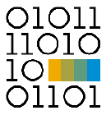
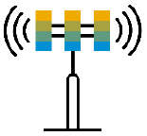
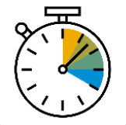
Drivers for Edge computing
Data Volume & Bandwidth Capacity
Intermittent Connectivity
Fast Decision Making
Devices are producing more raw data, Transmitting all of these data is costly and data is more than the bandwidth available – Technical and economic challenges
Devices are located a places with intermittent connectivity eg. Oil rigs, Container ships, Vessels. Connection is inconsistent and unreliable with low bandwidth
Decisions made from sensor data needs to be fast, eg. Train collision detection or automated self driving cars

Slide 21

Essential Business functions service for ERP and S4/HANA
Essential Business Functions Service provides business context (data and transactions) from ERP systems and S/4HANA at the edge
Edge Services can be extended to work with SAP ERP and S4/HANA
Extends SAP Plant Maintenance (PM), Materials Management (MM), Inventory Management (IM) functionality to the edge
Deep offline functionality is available for SAP Plant Maintenance and Materials Management
SAP Cloud Platform
Policy Service
S/4 HANA
ERP
EBF Service
EBF Service
SAP Cloud Platform IoT
S/4 HANA
Essential
Business
Functional
Service
EBF Service
IoT Edge Gateway
EDGE
IoT Gateway Hardware

Slide 22
Essential Business functions service for – SAP Asset Intelligence Network (AIN)
Essential Business Functions Service provides business context (data and transactions) at the edge
AIN unstructured data such as manuals
AIN structured data such as threshold
SAP Cloud Platform
Policy Service
AIN
EBF Service
SAP Cloud Platform IoT
Essential
Business
Functional
Service
IoT Edge Gateway
EDGE
IoT Gateway Hardware

Slide 23
SAP IoT Application Enablement
provides a wizard-based approach for accelerated enterprise IoT application development
Wizard-based approach for creating customized basic IoT applications
Code-free app development
Simple way to connect to the SAP backend services from IoT Application Enablement
Template uses a standard UI control library for IoT including geo maps, thing lists, thing card, event lists, sensor charts and embedded analytics
Live connection to data and live preview
Generated app can be directly deployed or customized with UI controls in the UI5 development editor

Slide 24
SAP Leonardo IoT Application Enablement Service
SAP Internet of Things (IoT) Application Enablement represents a network of physical objects known as “things,” which collect and exchange data. Use the services to set up a thing model, companies, and service personnel in a company and their relationships.
It also includes a collection of REST-based and OData-based services to efficiently store and retrieve data for things, companies, and service personnel.
The SAP Internet of Things (IoT) Application Enablement solution is a collection of services, apps, and UI templates that help you modeling digital twins of real-world objects that you want to monitor, track, or analyze.

Slide 25



SAP LEONARDO IOT APPLICATION ENABLEMENT SERVICE
SAP Leonardo IoT Bridge
Connected
Products
Connected
Assets
Connected
Fleet
Connected
Infrastructure
Connected
Markets
Connected People
SAP Leonardo IoT for Edge Computing
Streaming
Persistence
Business transactions
Predictive and machine learning
Analytics
SAP Leonardo IoT Foundation
Technical Services
Device Management
Connectivity
Messaging
Business Services
Thing Model(digital twin)
Application development
Big Data & Analytics
SAP CLOUD PLATFORM
Machine
Learning
Analytics
Mobile
Integration

Slide 26



Developer Experience
Develop
Applications using
SAP Web IDE
Deploy and Run
On
SAP Cloud Platform
Model
Business
Semantics
Thing Modeler & Device Mapping
IoT Application Templates
SAP- Web IDE SDK
Deploy Multi-target
Applications
Tenant Admin
Storyboard Perspective
Cloud Cockpit
UI Control Library
KPI & Analytics Modeler
Development Perspective
Portal Services
Rules Modeler
Business Logic Develoment (Java & Node.js)
Analytics Runtime Services

Slide 27
Application Enablement Services:
Application enablement offers three major Services:
To Setup, configure, populate, maintain and store IoT, Big data as well as authorization access and event management
To rapidly prototype IoT applications that can be easily extended from the generated source code.
Acts as a front end to much of the functionality delivered via the APIs, including thing modeling, authorization, and business partner relationships
API
IoT App for SAP WEB IDE
UI
Applications

Slide 28
ID SAP
SAP Leonardo
Thank you

